Slide 1

Software Design and Arcitecture(SDA) Lecture 4
Engr.Ramsha Mashood
Senior Lecturer
Department of Software Engineering
Bahria University Karachi Campus

Slide 2




Web Applications Design and Different architectural design

Slide 3
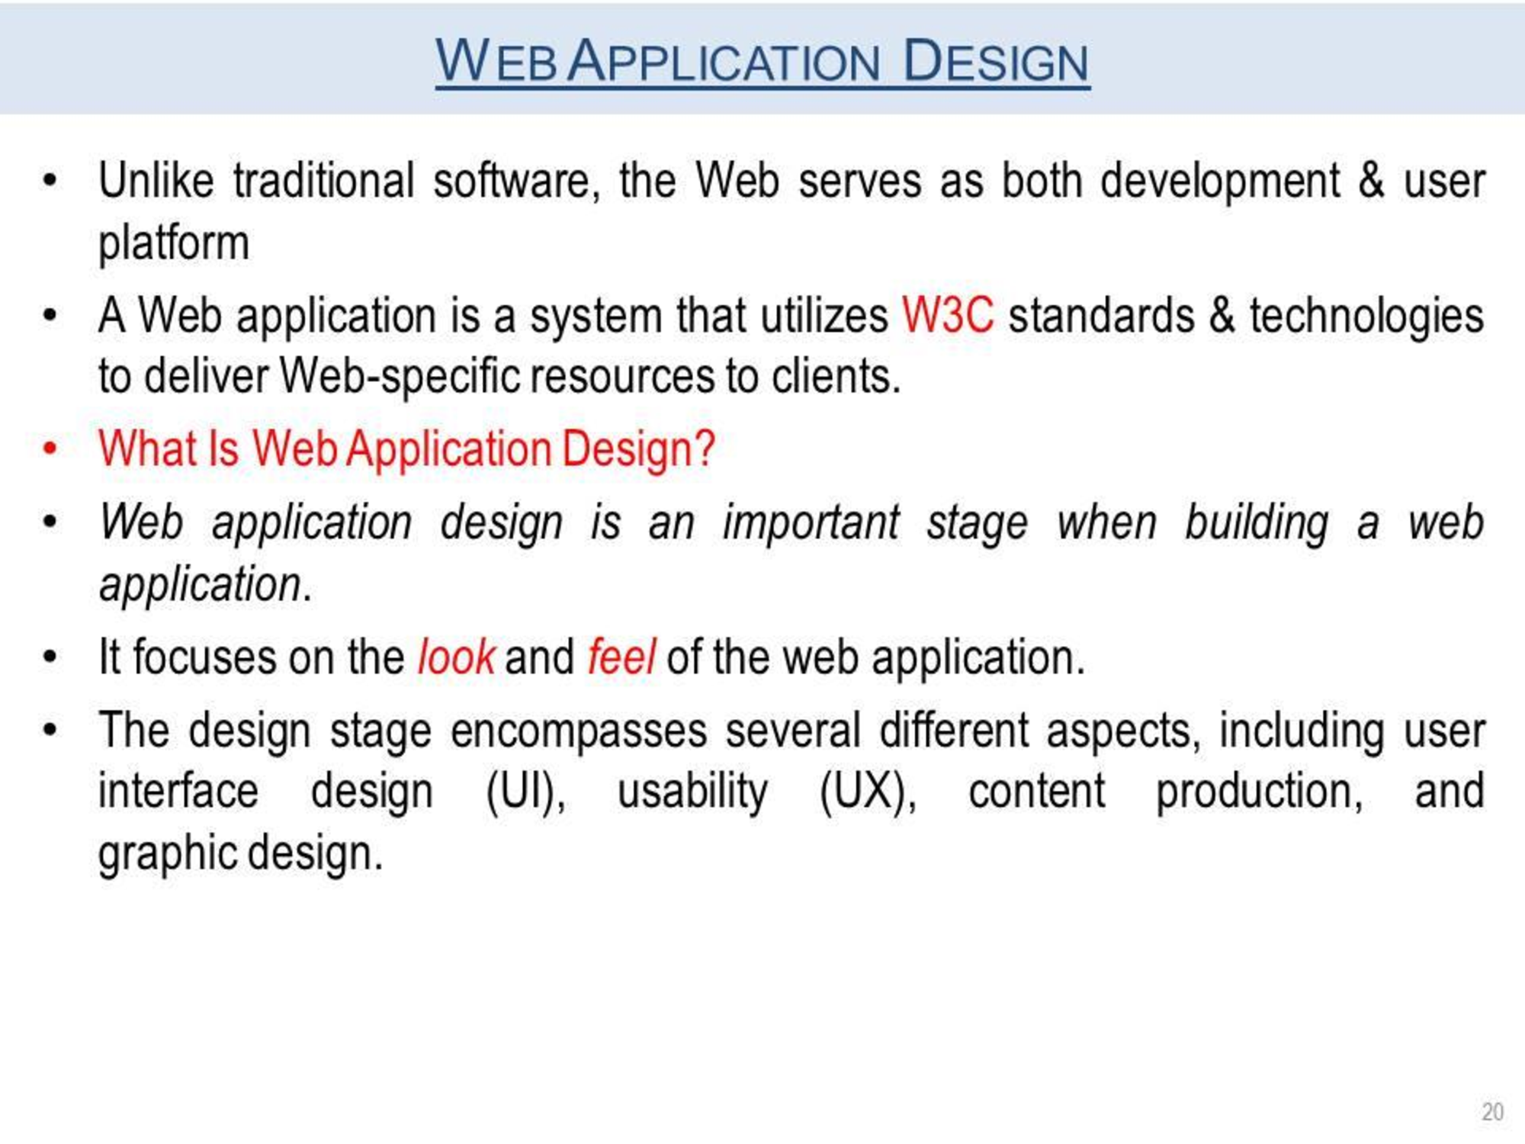

Slide 4
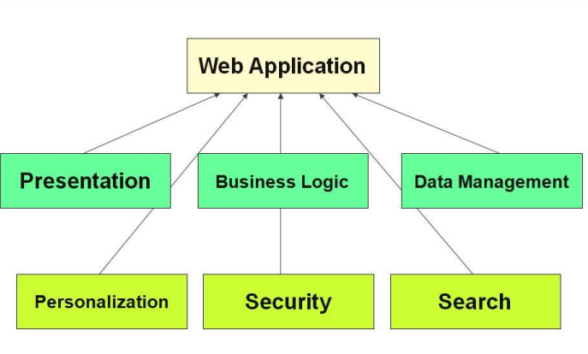
Web app

Slide 5
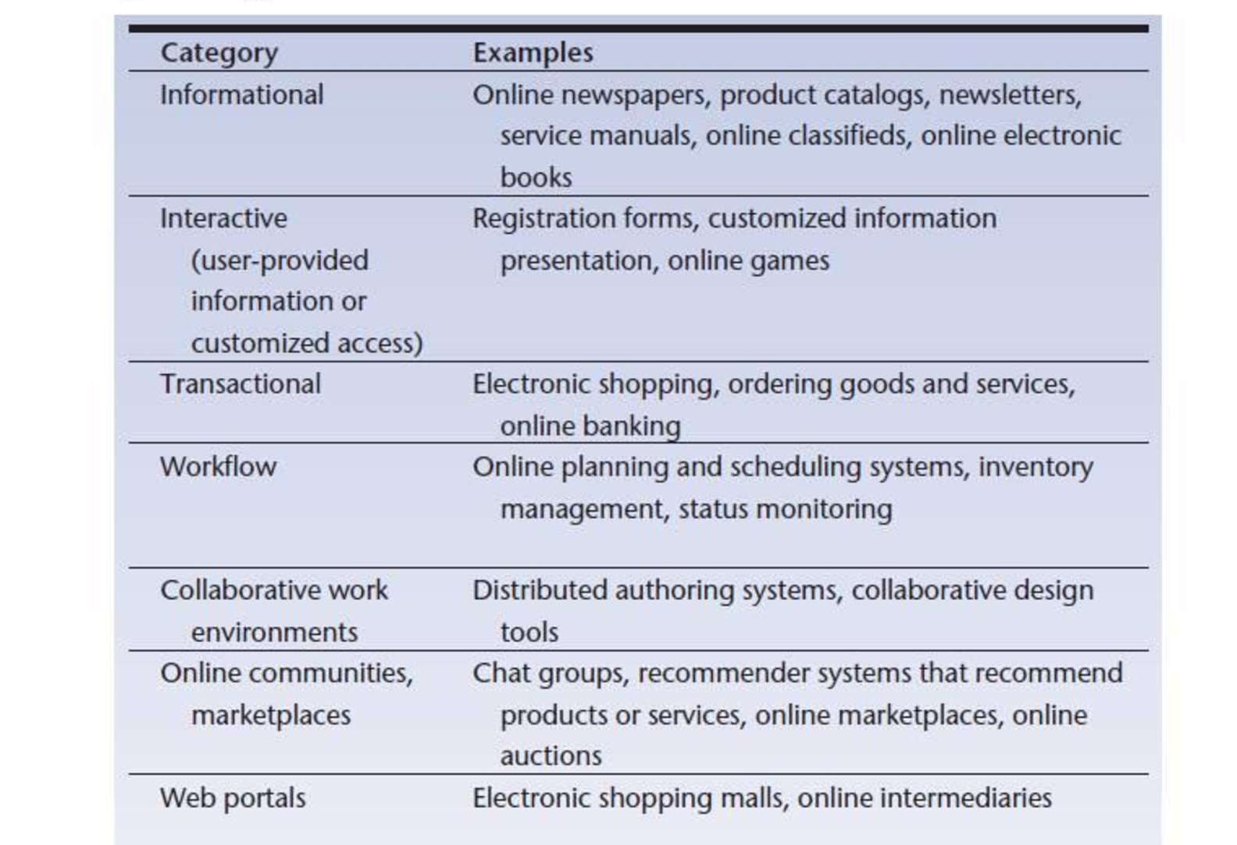
Categories

Slide 6
Types with example
Types of web applications ➤ Static web application- Blog post ➤ Dynamic web application- Facebook, Netflix ➤ E-commerce web application- Amazon, Ebay ➤ Content management system web application- wordpress,Webflow ➤ Single-page web application- Gmail, Paypal ➤ Multiple-pages web application- Google Docs ➤ Portal web application - Coursera ➤ Animated web application – Google’s Your Plan ➤ Rich internet web application - ➤ Progressive web application - Spotify

Slide 7
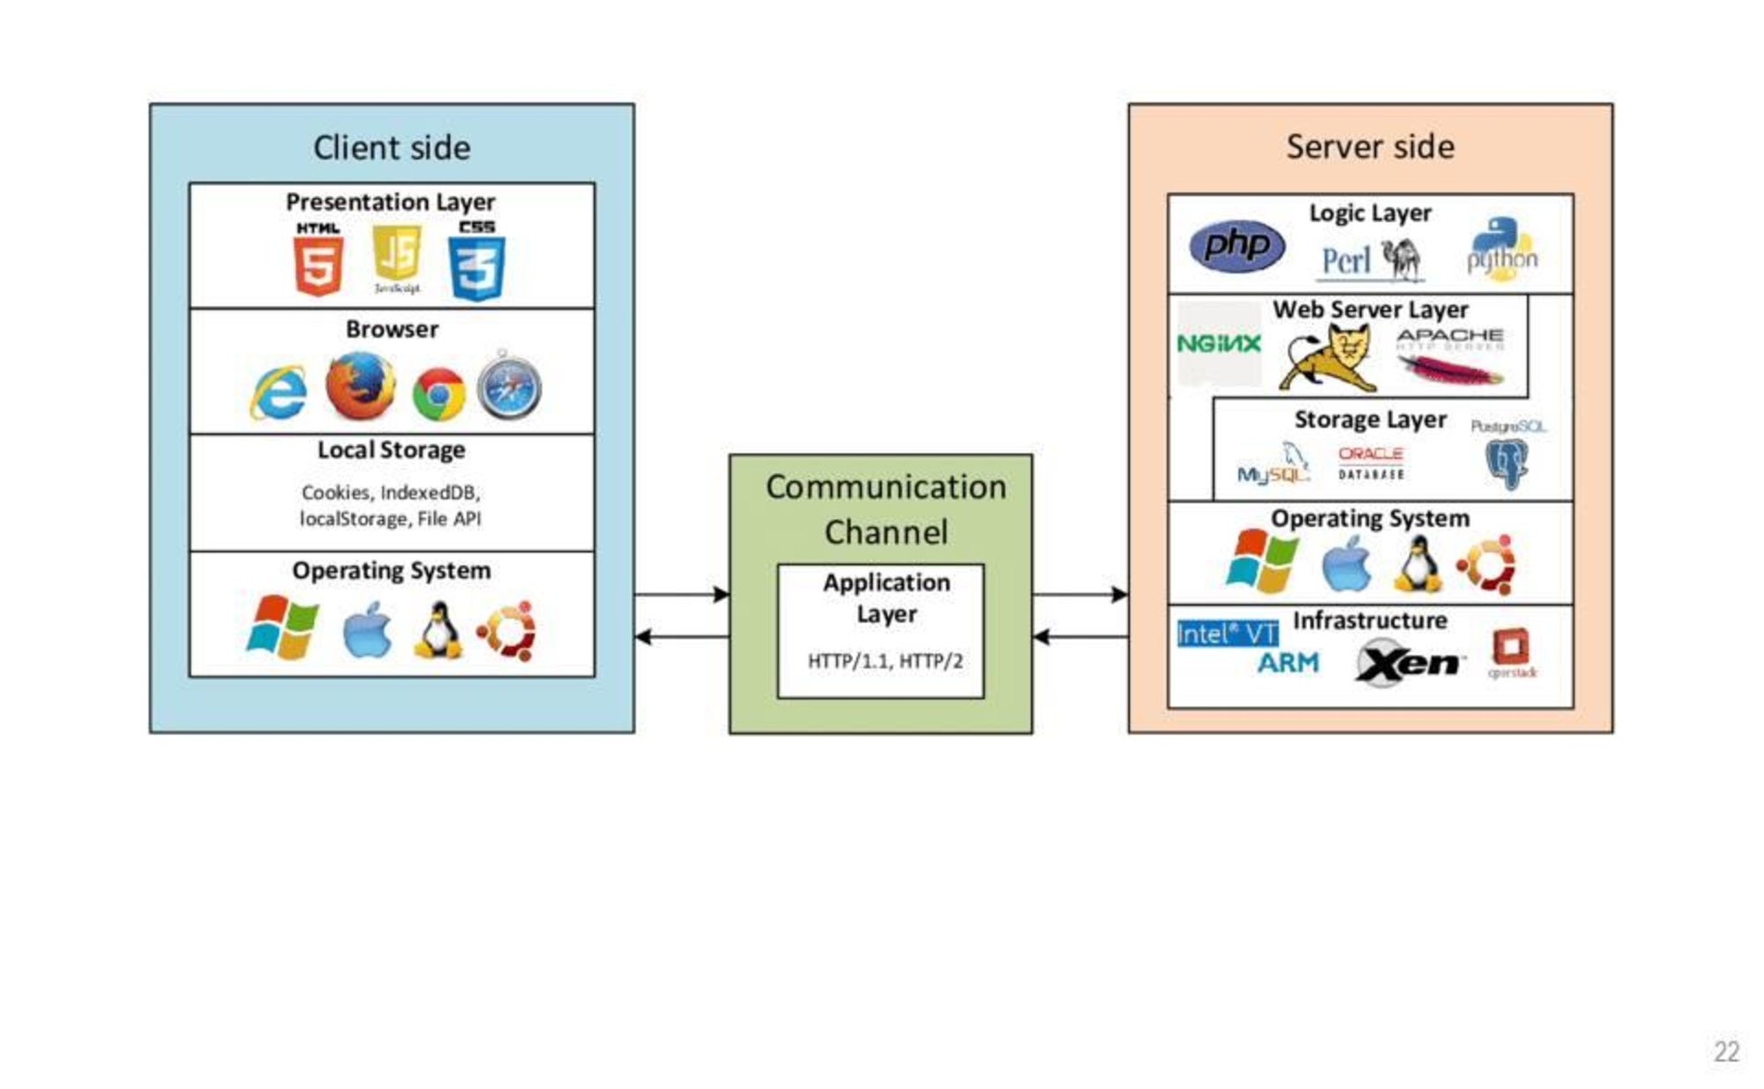
Web application

Slide 8

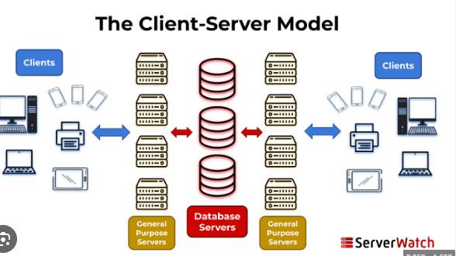

Slide 9
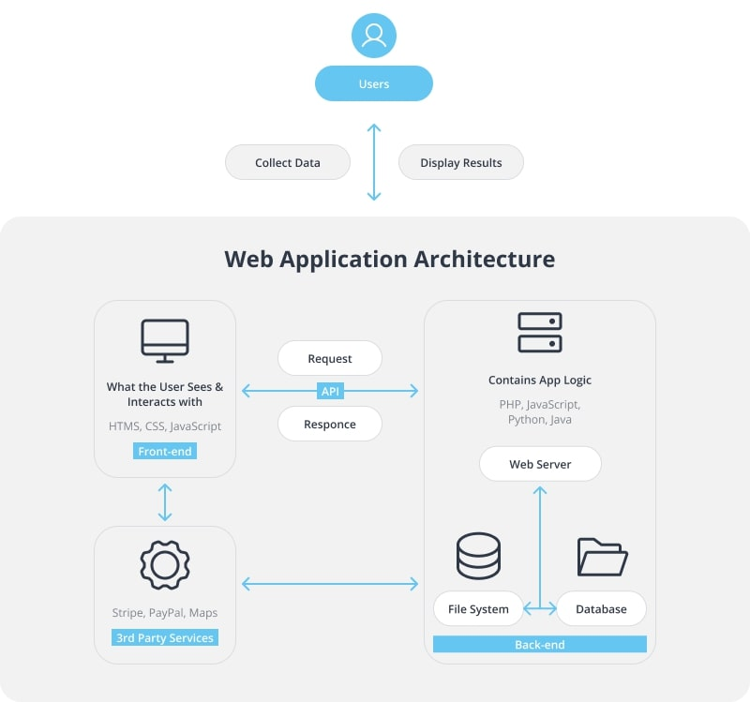

Slide 10
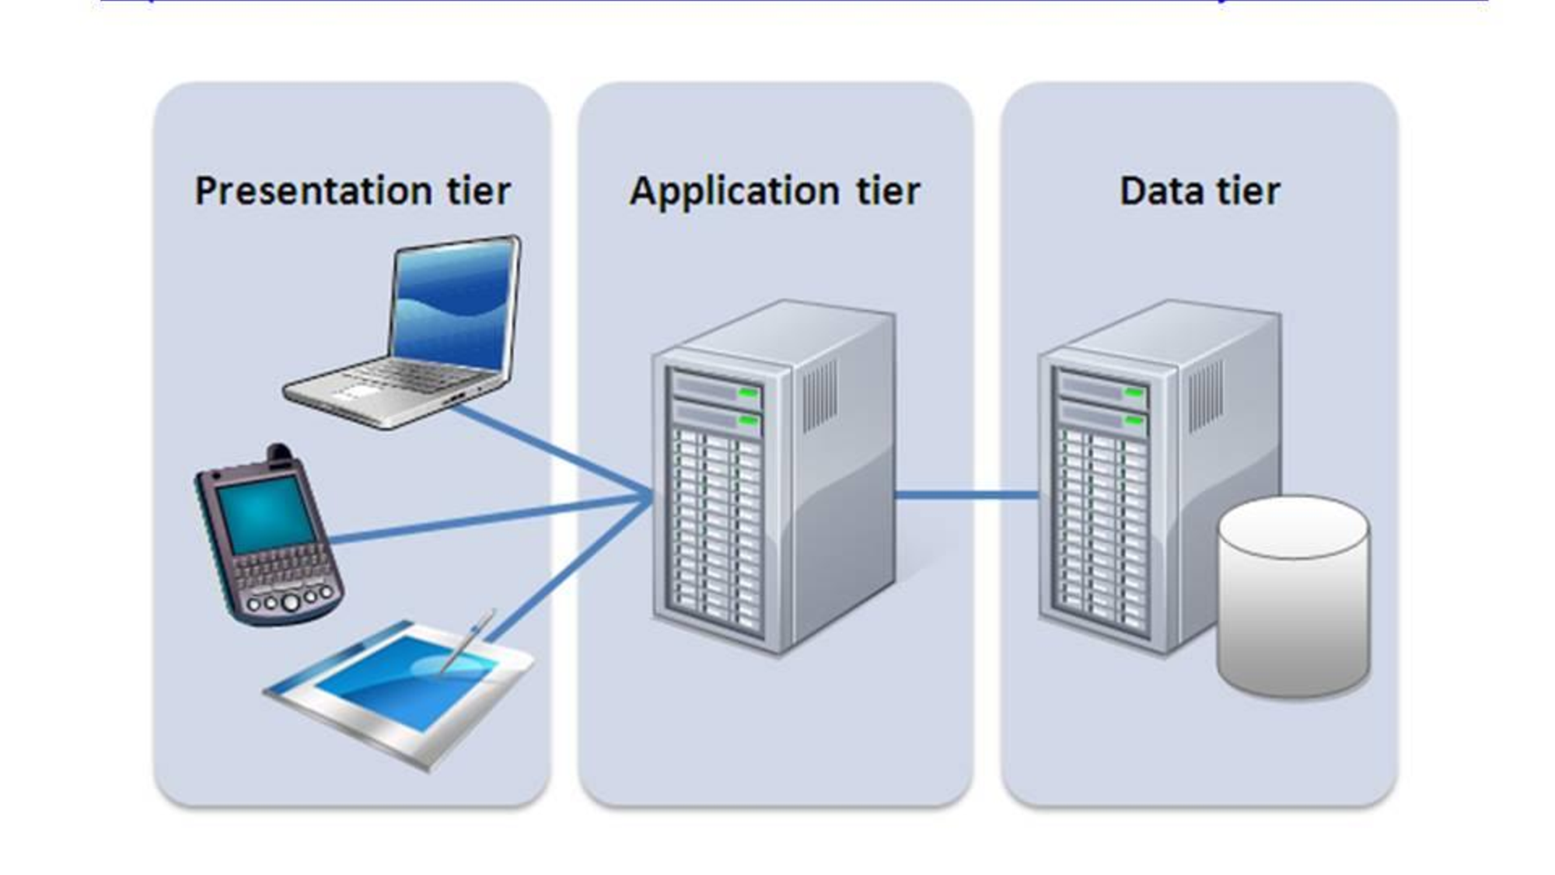
Tier vs layer

Slide 11
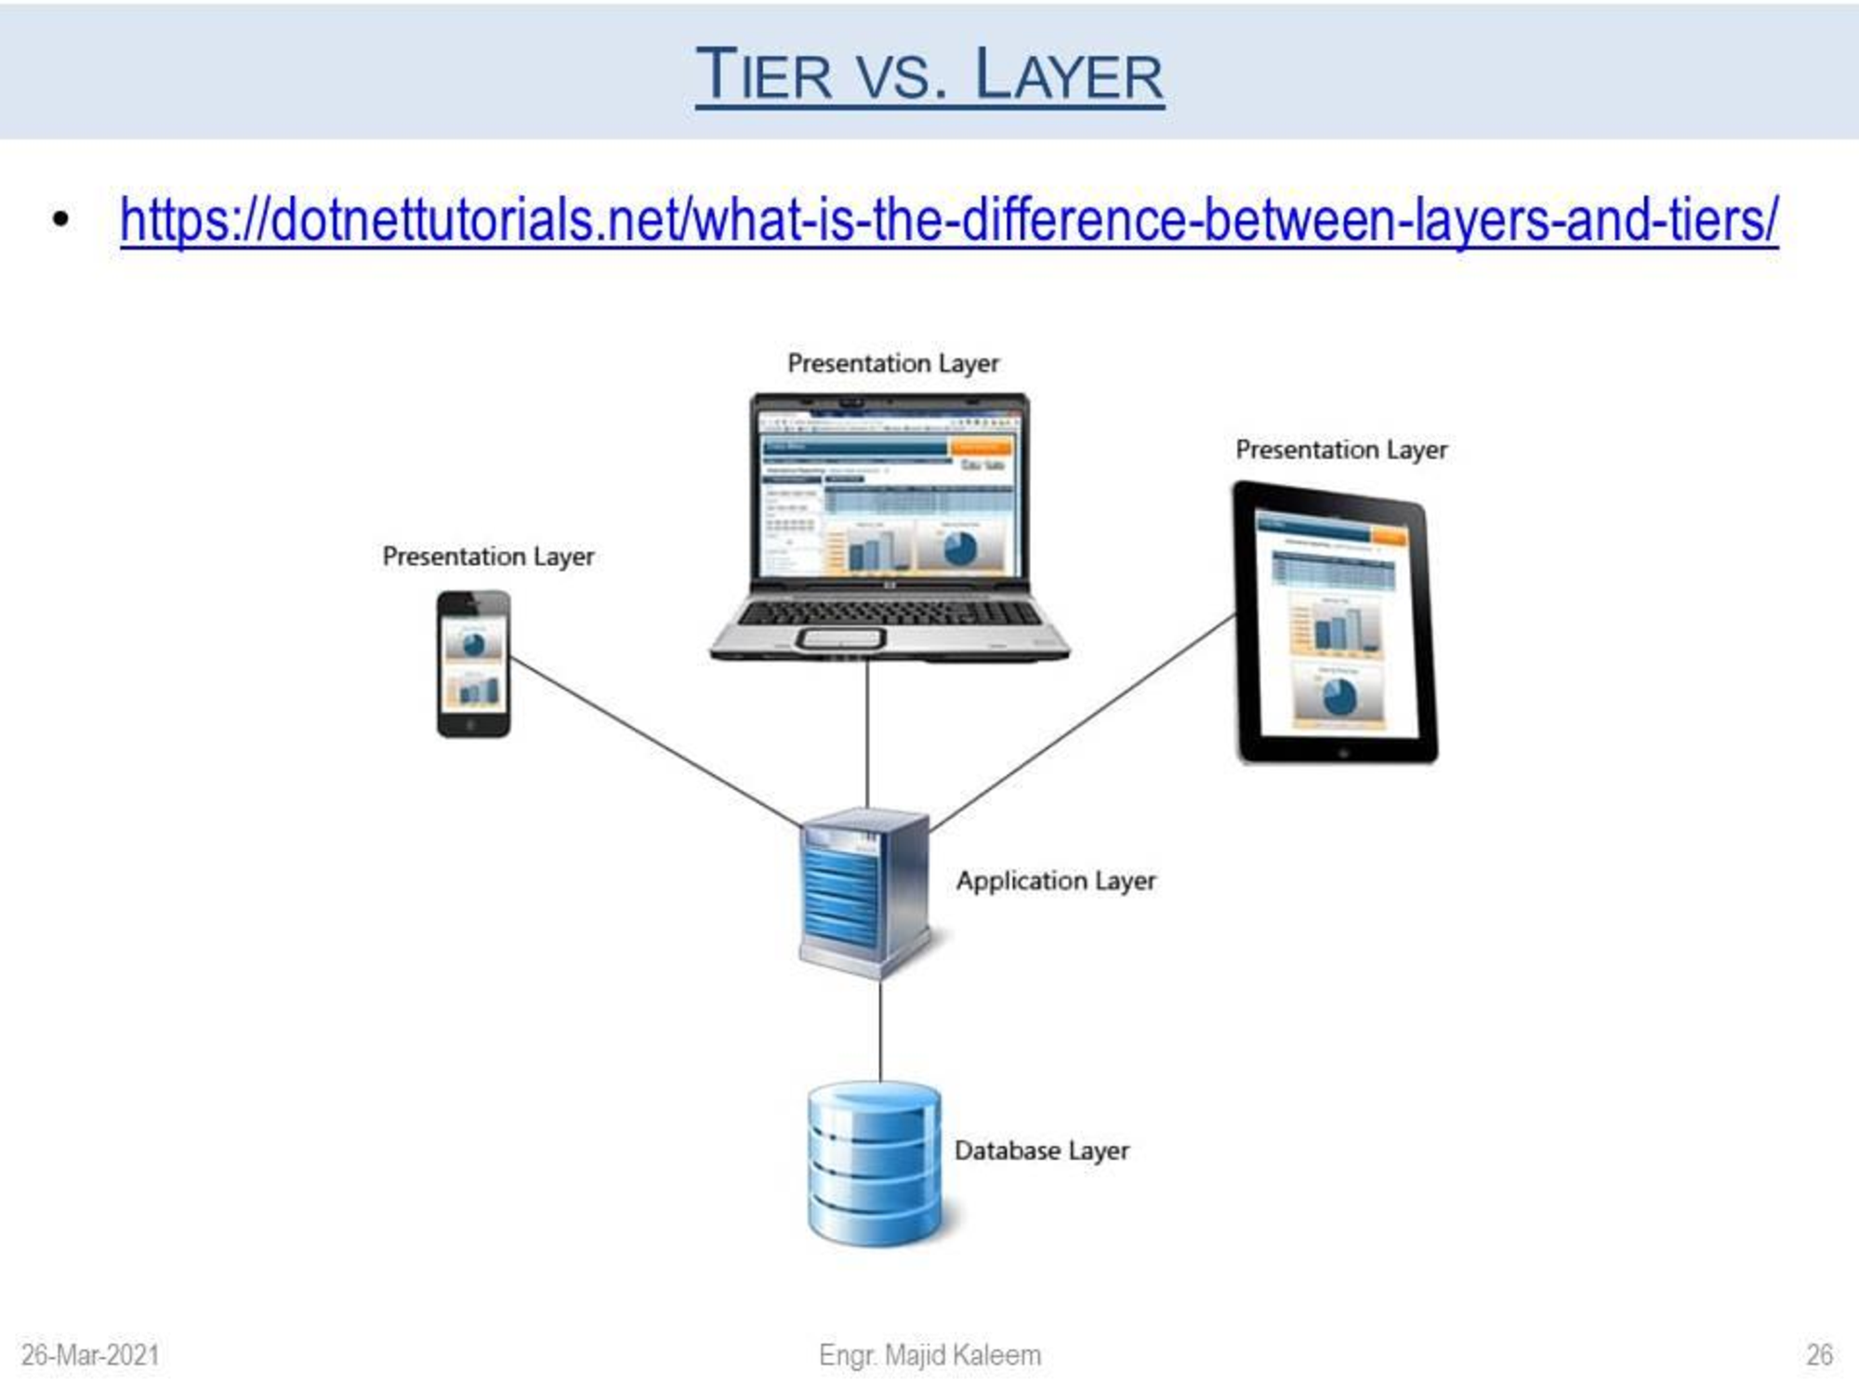

Slide 12
difference
They aren't the same. A 'layer' refers to a functional division of the software, but a 'tier' refers to a functional division of the software that runs on infrastructure separate from the other divisions.
The Contacts app on your phone, for example, is a three-layer application, but a single-tier application, because all three layers run on your phone.

Slide 13
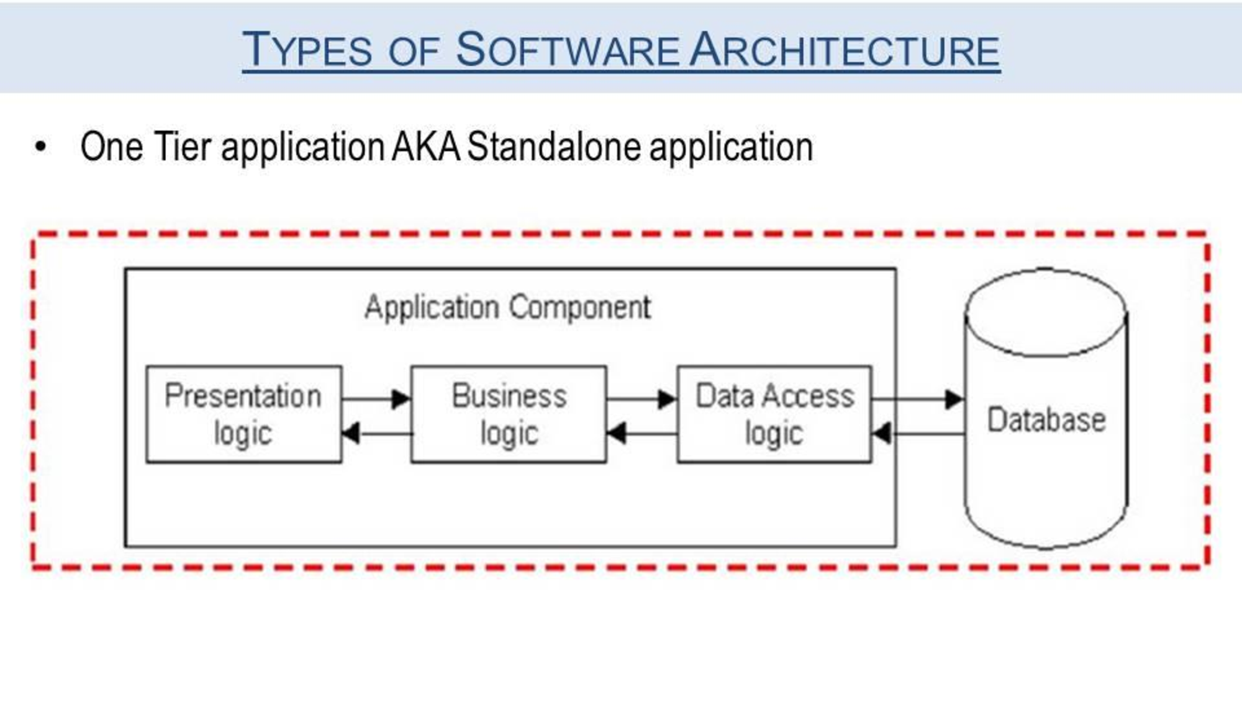

Slide 14
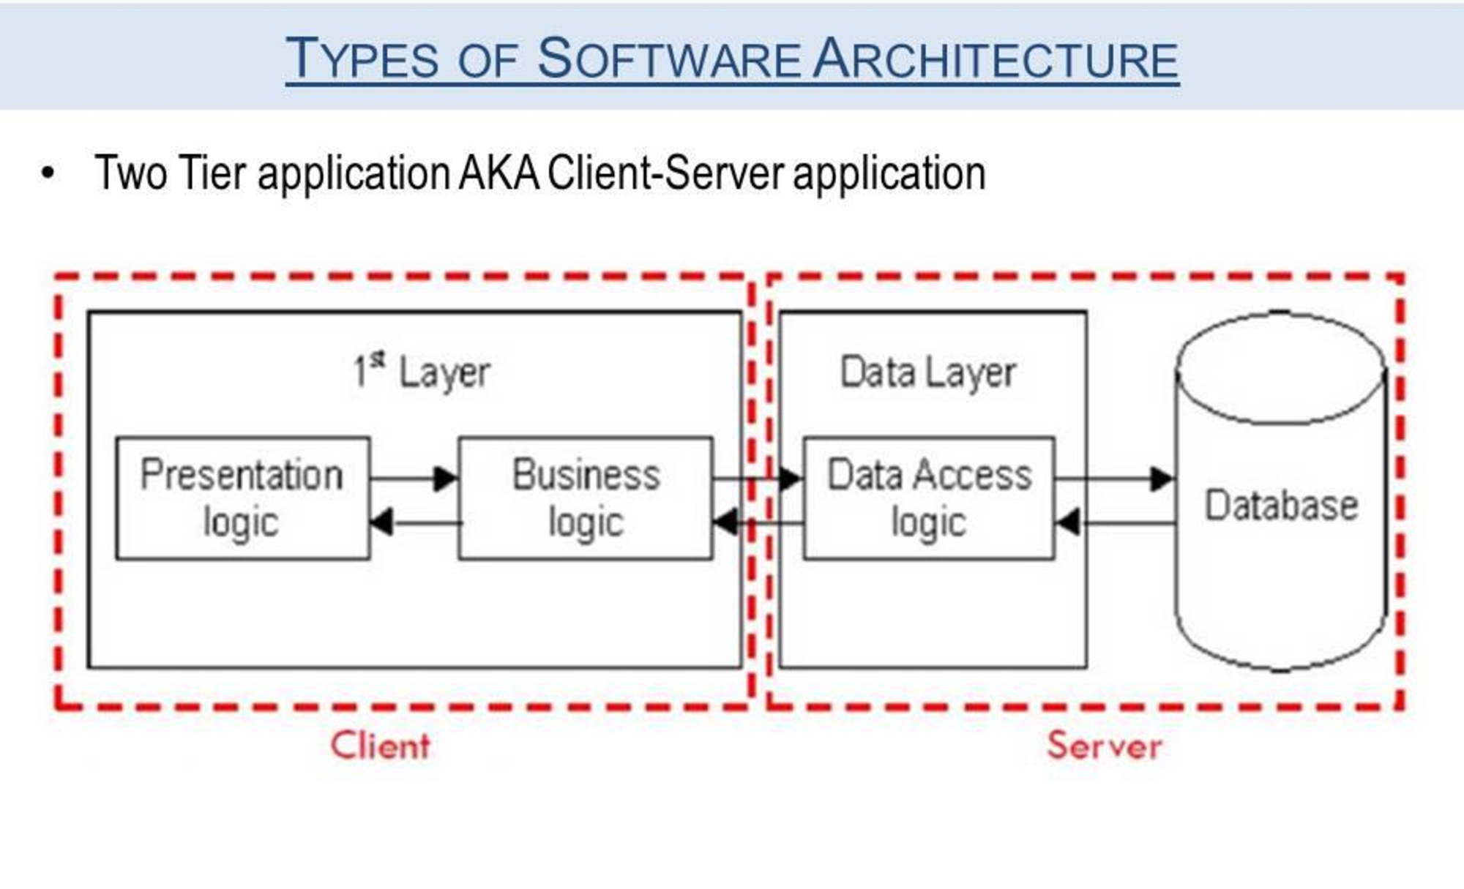

Slide 15
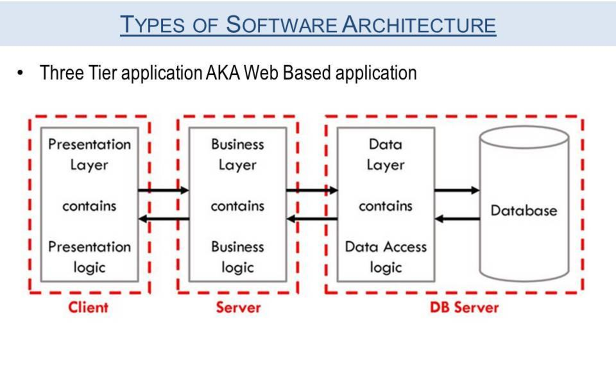

Slide 16
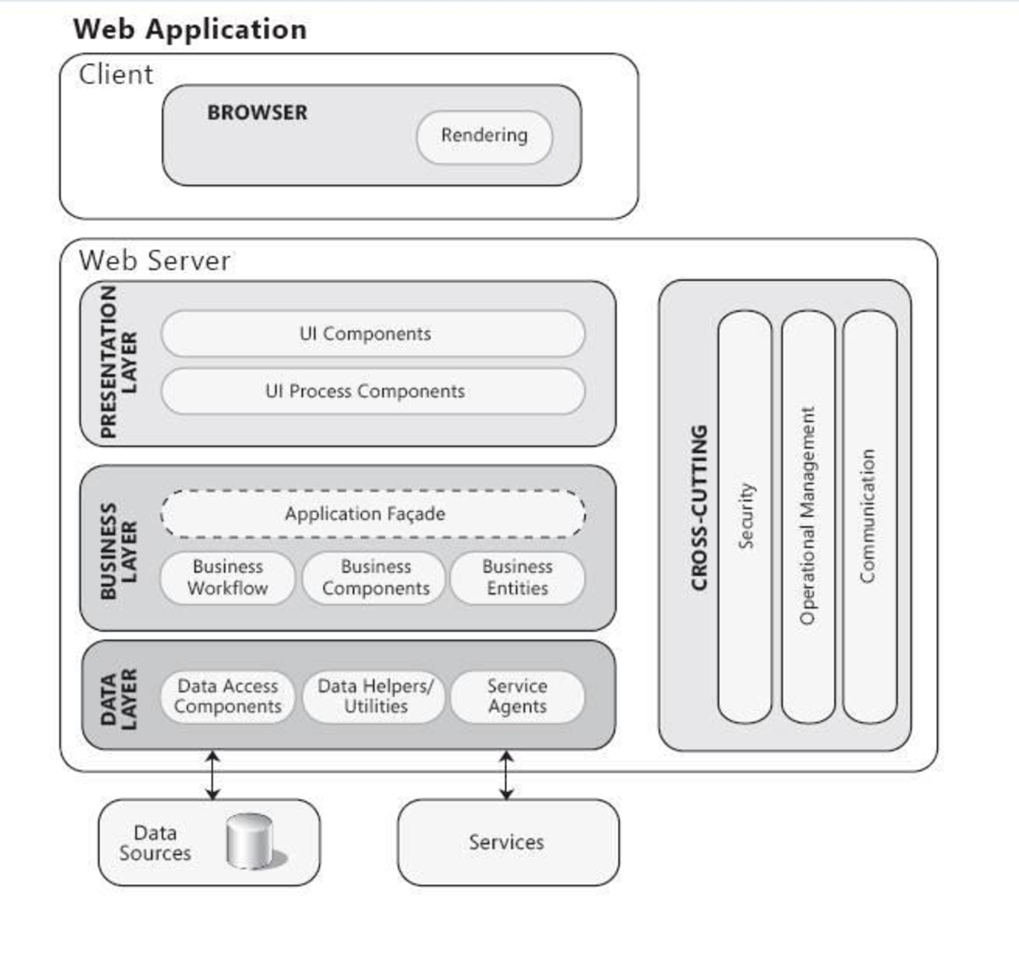
Web application

Slide 17
Design issues
User Interface (UI) Design:
Navigation and Information Architecture:
Responsive Design for Multiple Devices:
Accessibility:
Performance Optimization:
Security Measures:
Scalability:
Cross-Browser Compatibility:
SEO (Search Engine Optimization):
Content Management System (CMS):

Slide 18
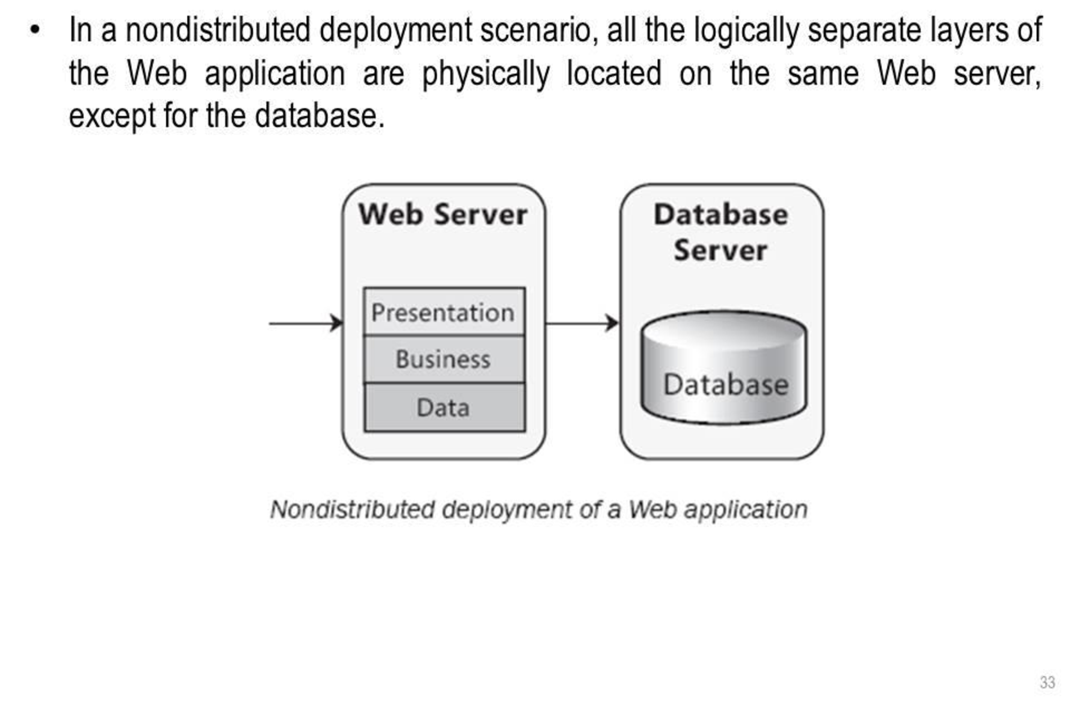
Non distributed deployment

Slide 19
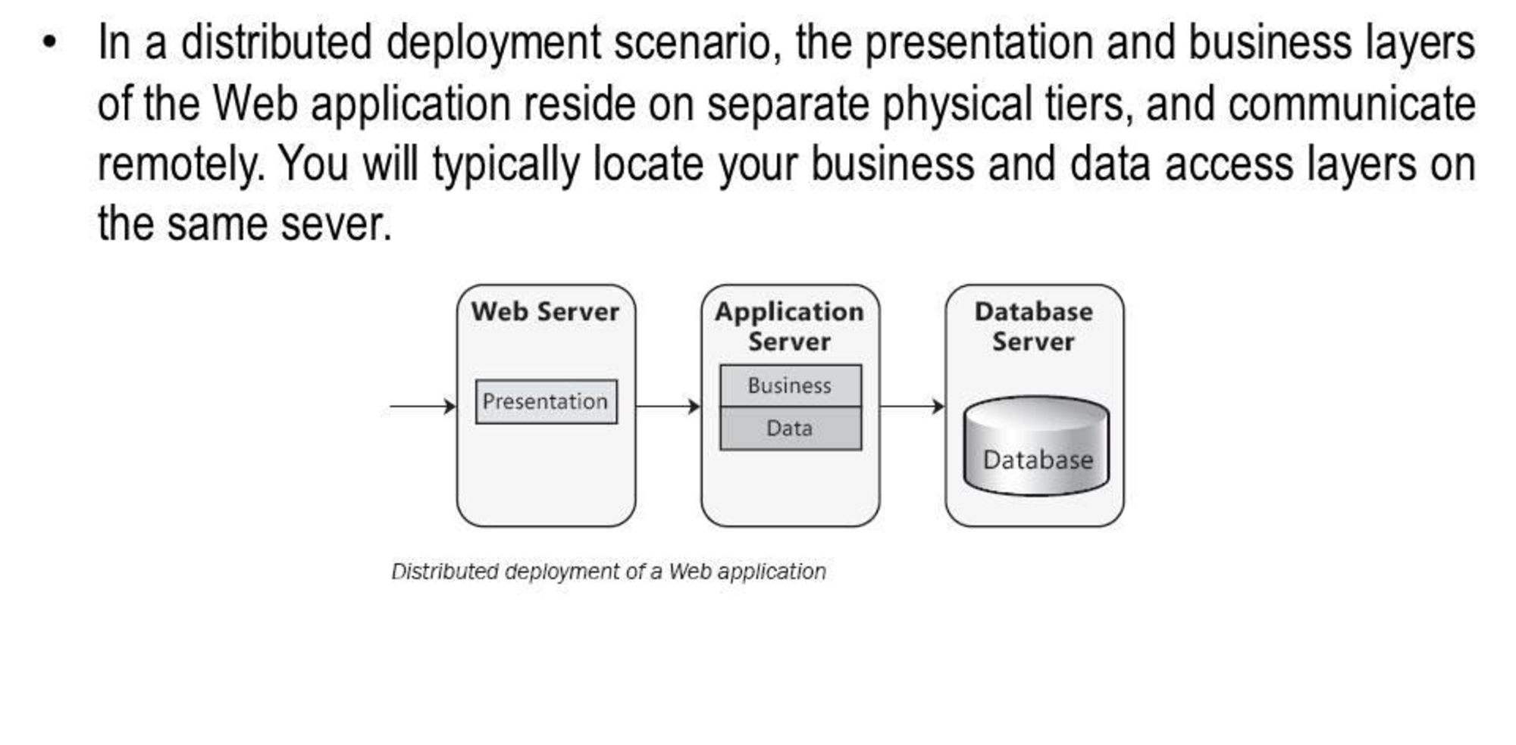
Distributed deployment

Slide 20
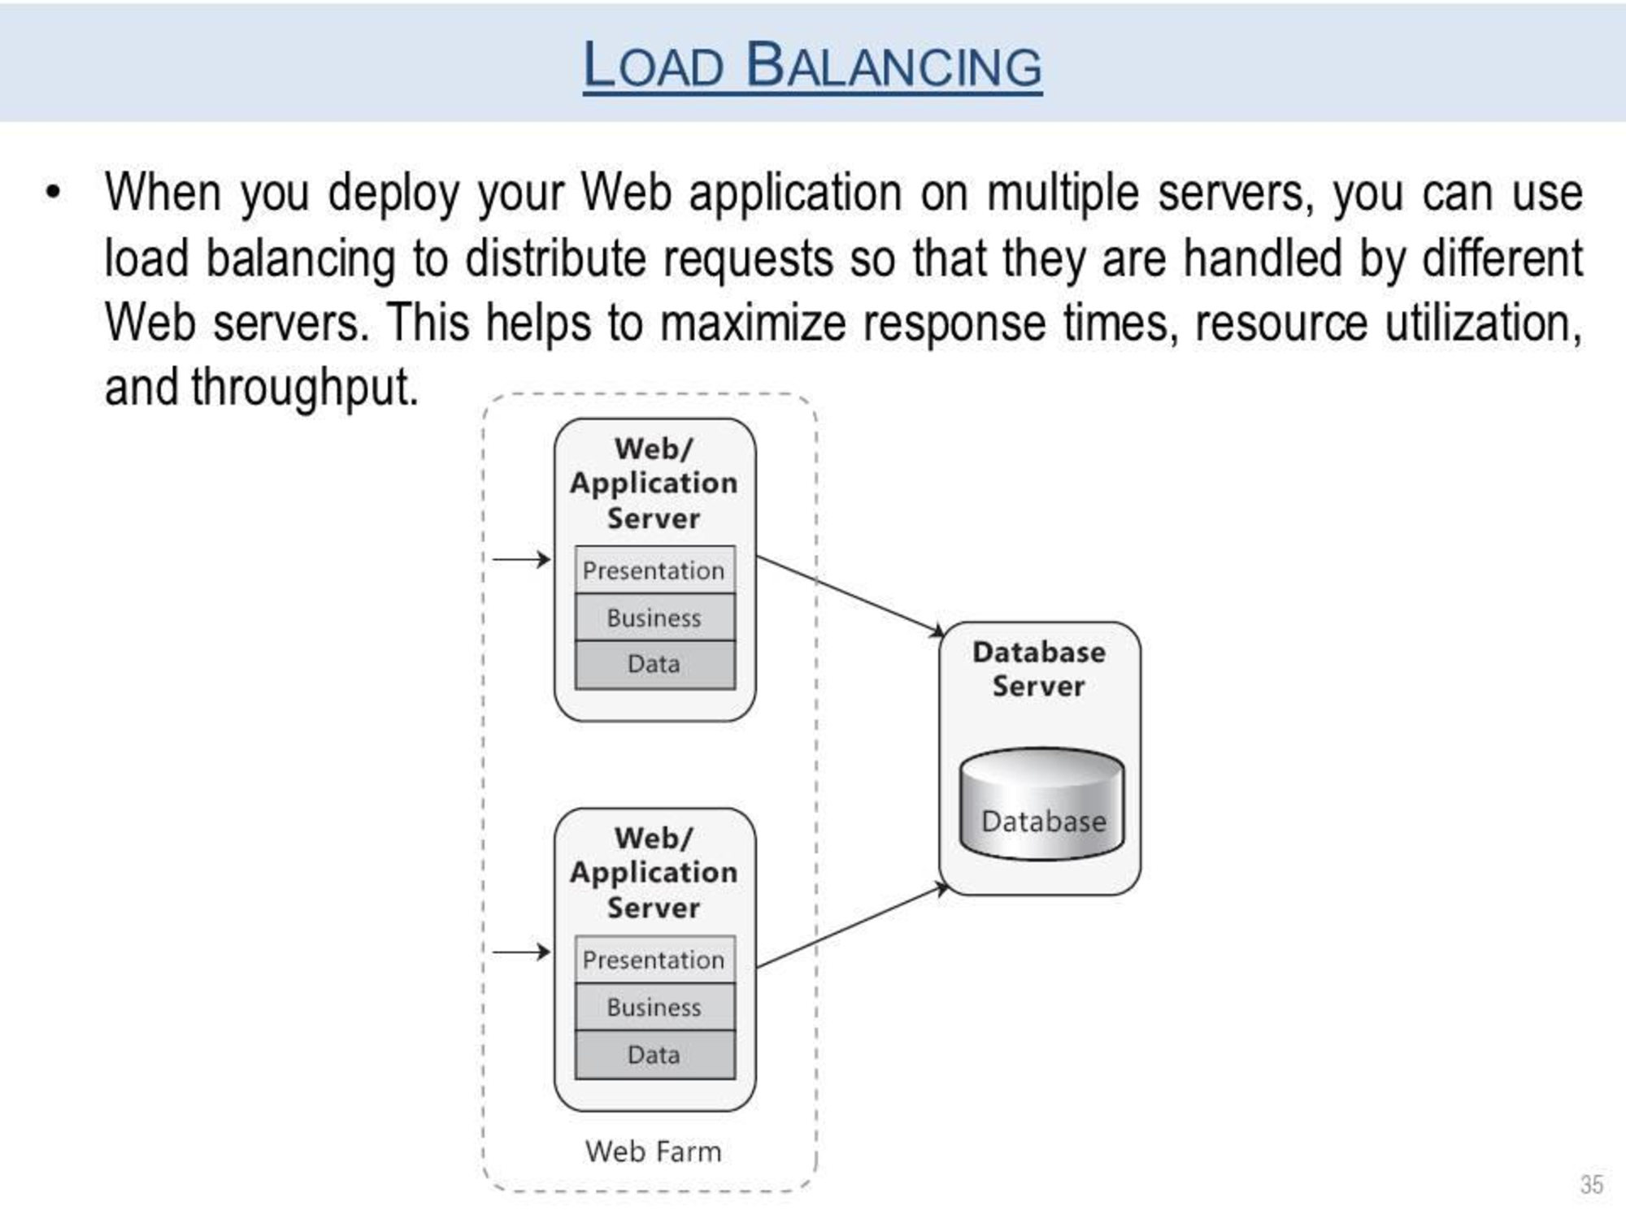
Load balancing

Slide 21
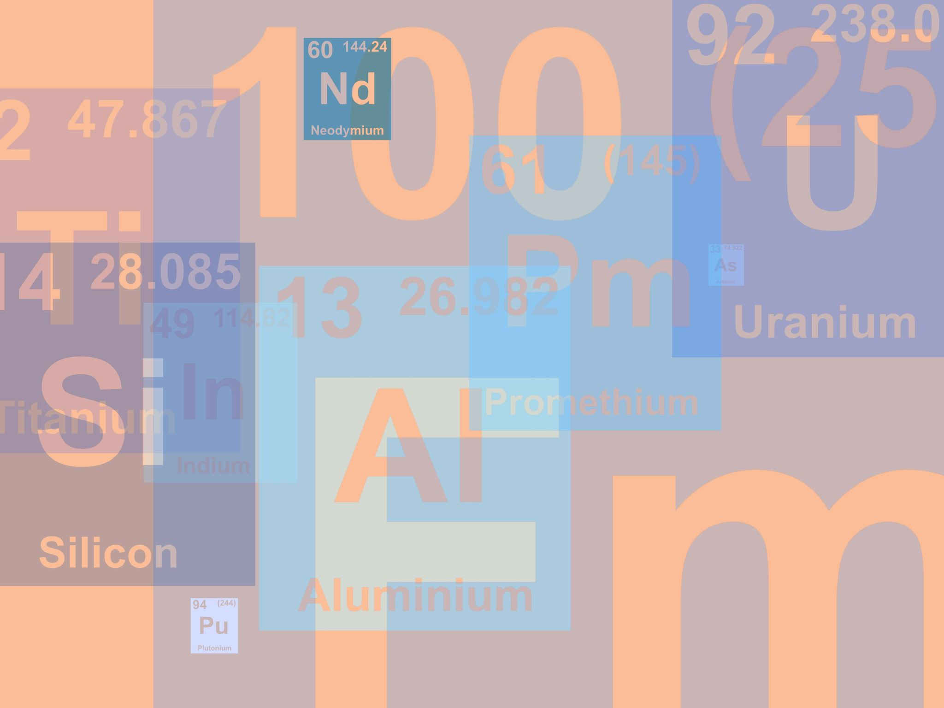
MVC Architecture
In object-oriented programming development, model-view-controller (MVC) is the name of a methodology or design pattern for successfully and efficiently relating the user interface to underlying data models.
The MVC pattern is widely used in program development with programming languages such as Java, Smalltalk, C, and C++.
The MVC pattern has been heralded by many developers as a useful pattern for the reuse of object code and a pattern that allows them to significantly reduce the time it takes to develop applications with user interfaces.

Slide 22

Three Components
Models. Model objects are the parts of the application that implement the logic for the application's data domain. Often, model objects retrieve and store model state in a database. For example, a Product object might retrieve information from a database, operate on it, and then write updated information back to a Products table in a SQL Server database.
In small applications, the model is often a conceptual separation instead of a physical one. For example, if the application only reads a dataset and sends it to the view, the application does not have a physical model layer and associated classes. In that case, the dataset takes on the role of a model object.
Views. Views are the components that display the application's user interface (UI). Typically, this UI is created from the model data. An example would be an edit view of a Products table that displays text boxes, drop-down lists, and check boxes based on the current state of a Product object.
Controllers. Controllers are the components that handle user interaction, work with the model, and ultimately select a view to render that displays UI. In an MVC application, the view only displays information; the controller handles and responds to user input and interaction. For example, the controller handles query-string values, and passes these values to the model, which in turn might use these values to query the database.

Slide 23
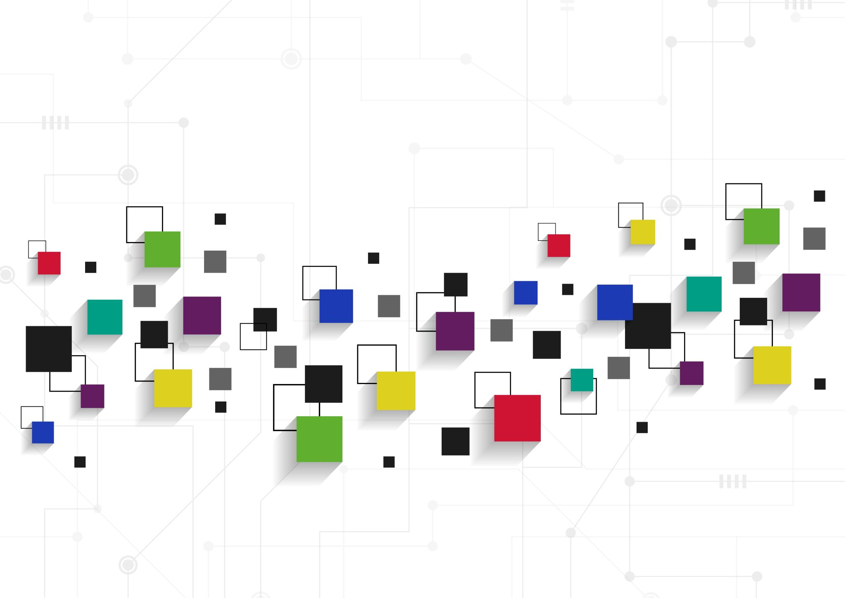
In-Depth
The MVC pattern helps you create applications that separate the different aspects of the application (input logic, business logic, and UI logic), while providing a loose coupling between these elements. The pattern specifies where each kind of logic should be located in the application.
The UI logic belongs in the view.
Input logic belongs in the controller.
Business logic belongs in the model.
This separation helps you manage complexity when you build an application, because it enables you to focus on one aspect of the implementation at a time. For example, you can focus on the view without depending on the business logic.
The loose coupling between the three main components of an MVC application also promotes parallel development. For example, one developer can work on the view, a second developer can work on the controller logic, and a third developer can focus on the business logic in the model.

Slide 24
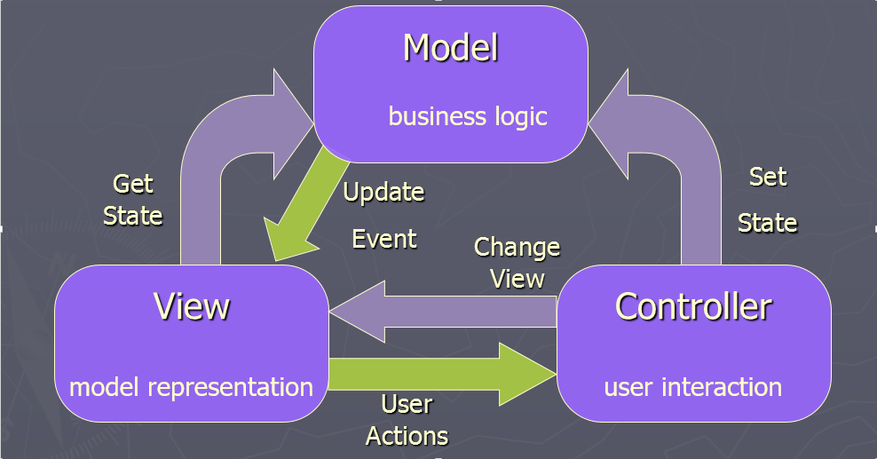
Architecture Diagram

Slide 25
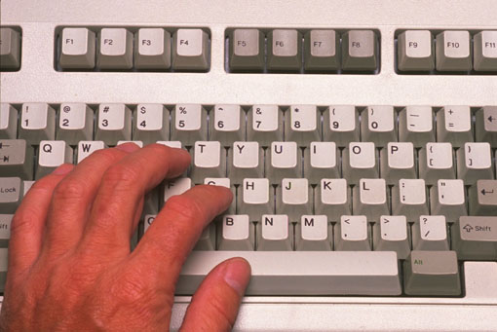
Further
View
Model
Controller

Slide 26

Support for Test-Driven Development
In addition to managing complexity, the MVC pattern makes it easier to test applications than it is to test a Web Forms-based ASP.NET Web application.
For example, in a Web Forms-based ASP.NET Web application, a single class is used both to display output and to respond to user input.
Writing automated tests for Web Forms-based ASP.NET applications can be complex, because to test an individual page, you must instantiate the page class, all its child controls, and additional dependent classes in the application. Because so many classes are instantiated to run the page, it can be hard to write tests that focus exclusively on individual parts of the application.
Tests for Web Forms-based ASP.NET applications can therefore be more difficult to implement than tests in an MVC application.
Moreover, tests in a Web Forms-based ASP.NET application require a Web server. The MVC framework decouples the components and makes heavy use of interfaces, which makes it possible to test individual components in isolation from the rest of the framework.

Slide 27
Advantages of an MVC-Based Web Application
It makes it easier to manage complexity by dividing an application into the model, the view, and the controller.
It does not use view state or server-based forms. This makes the MVC framework ideal for developers who want full control over the behavior of an application.
It provides better support for test-driven development (TDD).
It works well for Web applications that are supported by large teams of developers and for Web designers who need a high degree of control over the application behavior.

Slide 28
Useful links
https://uit.stanford.edu/pmo/functional-design
https://volute.co.uk/blog/is-your-website-dda-compliant
https://www.melonwebdesign.co.uk/blog/a-brief-introduction-to-dda-compliance.html
https://tela.uk/2017/01/website-accessibility-checks/
https://visionict.com/DDA_Compliance_25682.aspx

Slide 29
Continue….
Any thing to ask ??

